Slide 1
PRIVACY IN THE CLOUD USING BLOCK CHAIN TECHNOLOGY
PRESENTED BY
ANBARASU P 710018104005
KRISHNA V 710018104019
MAIKANDAN M 710018104022
YASWANTHKUMAR T 710018104054
GUIDED BY
Dr.J.PREETHI,M.E.,Ph.D.
ASSISTANT PROFESSOR
DEPARTMENT OF CSE

Slide 2
CONTENTS
Abstract
Objective
Literature Survey
Existing System
Proposed System
Architecture
Advantages & Disadvantages
System Requirements
Implementation Details
Conclusion
Reference

Slide 3
ABSTRACT
Private data is transmitted and stored online every second. Therefore, security and privacy assurances should be provided at all times. Usage of block chain provides the best and better way of securing the data
However, that is not always the case. Private information is often unwillingly collected, sold, or exposed, depriving data owners of their rightful privacy.

Slide 4
OBJECTIVE
The main objective is to provide the security through the various block chain encryption algorithm

Slide 5

BLOCKCHAIN
Blockchain is a system of recording information in a way that makes it difficult or impossible to change, hack, or cheat the system. A blockchain is essentially a digital ledger of transactions that is duplicated and distributed across the entire network of computer systems on the blockchain.

Slide 6
LITERATURE SURVEY
Title of the Paper | Description | Provider
Towards Trusted Cloud Computing Authors : Nuno Santos, Krishna P. Gummadi Rodrigo Rodrigues | Cloud computing infrastructures enable companies to reduces costs by outsourcing. Clients of cloud computing services currently have no means of verifying the confidentiality and integrity of their data and computation. To address this problem to propose the design of a Trusted Cloud Computing Platform (TCCP). | Amazon EC2

Slide 7
LITERATURE SURVEY
Title of the Paper | Description | Provider
Seeding Clouds with Trust Anchors Authors : Joshua Schiffman and his co-authors | The paper for the customers security, critical data processing needs are beginning to push back strongly against using cloud computing. Cloud verifier service that generates integrity proofs . Protect the integrity of customer’s application VMs in IaaS clouds. | Cloud vendors run their computations upon cloud provided VM systems

Slide 8
EXISTING SYSTEM
Our current encryption techniques are mainly based on RSA, AES algorithms, though thus far it has been effective to use there are other better alternatives available

Slide 9
PROPOSED SYSTEM
In this project work we use Elliptical Curve Cryptography and Diffie Hellman algorithm(DH) as a Proposed System attempt to learning the patient centric resolve the trouble of evaluate a purpose equally by several parties on their personal inputs protected sharing of file sharing in VM Cloud stored on semi-trusted servers, and focus on addressing the difficult and challenging key organization issues.

Slide 10
ADVANCED ENCRYPTION STANDARD
It is a Symmetric Block Cipher.
Ciphers use same key for both Encryption and Decryption.
It include 3 block ciphers.
It sends original message(plain text) into Cipher text.

Slide 11
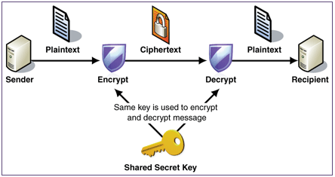
ADVANCED ENCRYPTION STANDARD

Slide 12
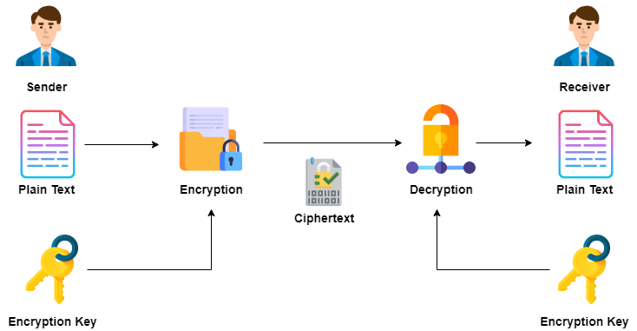
RIVEST SHAMIR ADLEMAN

Slide 13
DIFFIE HELLMAN
Diffie-Hellman key exchange, also called exponential key exchange, is a method of digital encryption that uses numbers raised to specific powers to produce decryption keys on the basis of components that are never directly transmitted, making the task of a would-be code breaker mathematically overwhelming

Slide 14
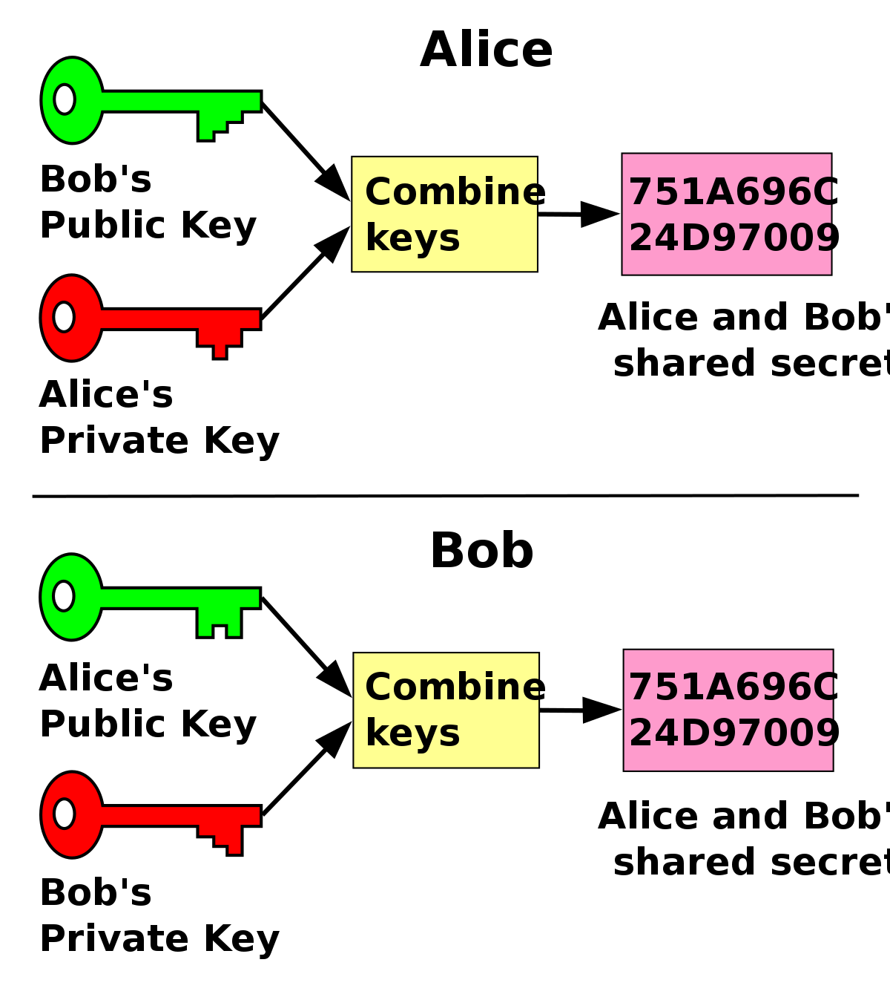
DIFFIE HELLMAN

Slide 15
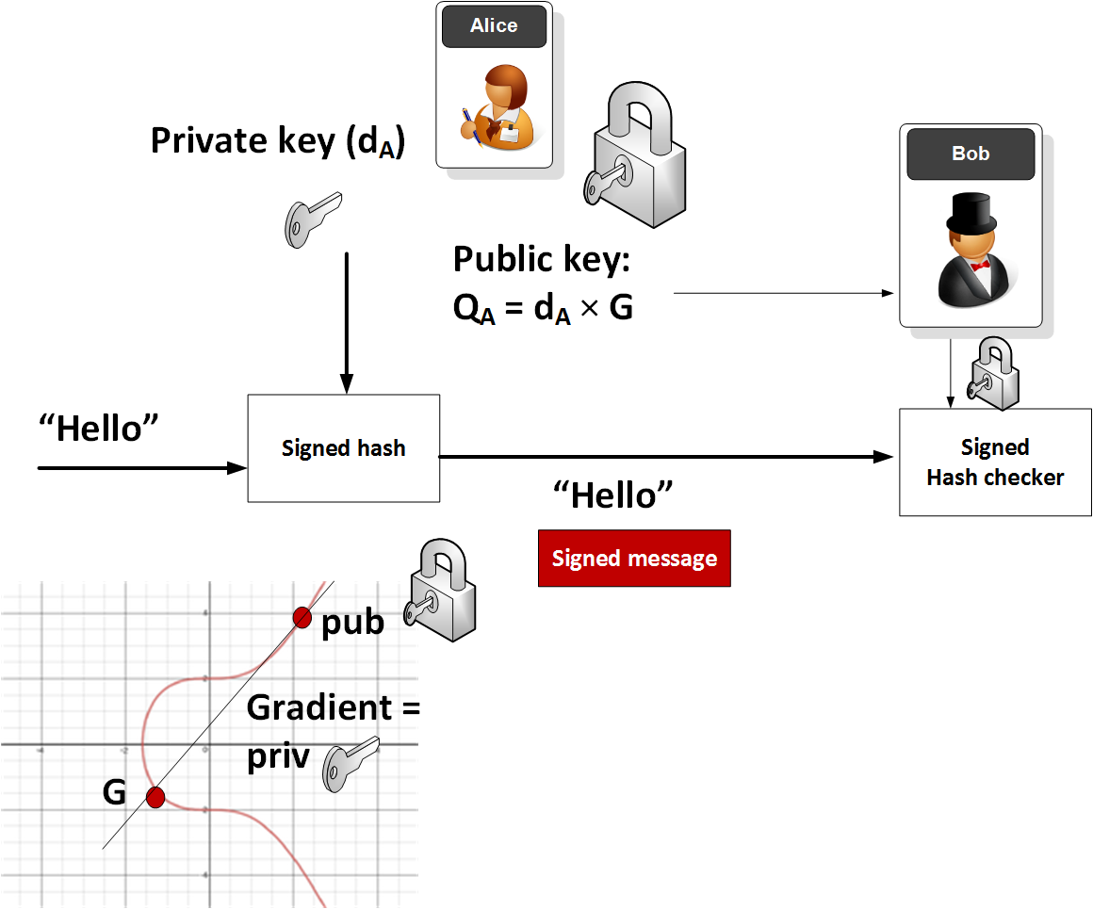
ELLIPTIC CURVE CRYPTOGRAPHY

Slide 16
IMPLEMENTATION DETAIL
REGISTRATION AND ENCRYPTION
A user registration generally asks a user to create a username and password.
Encryption is the process of translating plain text data (plaintext) into something that appears to be random and meaningless (ciphertext).
Decryption is the process of converting ciphertext back to plaintext.

Slide 17
DATA STORAGE
The server itself is a easy servlet this is related to a database.
It gets the encrypted message from the customer and decrypts it the usage of the shared key item generated through the Diffie-Hellman’s set of rules.

Slide 18
SYSTEM REQUIREMENTS
HARDWARE REQUIREMENTS
Processor Type
Speed
RAM
Hard disk
: Pentium i3
: 3.40GHZ
: 4GB DD2 RAM
: 500 GB
SOFTWARE REQUIREMENTS
Operating System
Front end
Coding Language
: Windows 10
: Eclipse IDE / jdk
: Java

Slide 19

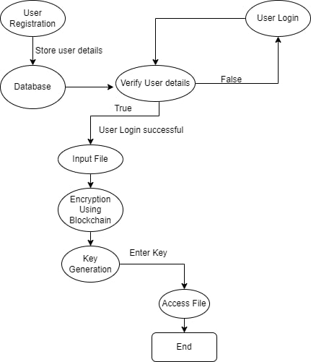
Working Flow

Slide 20
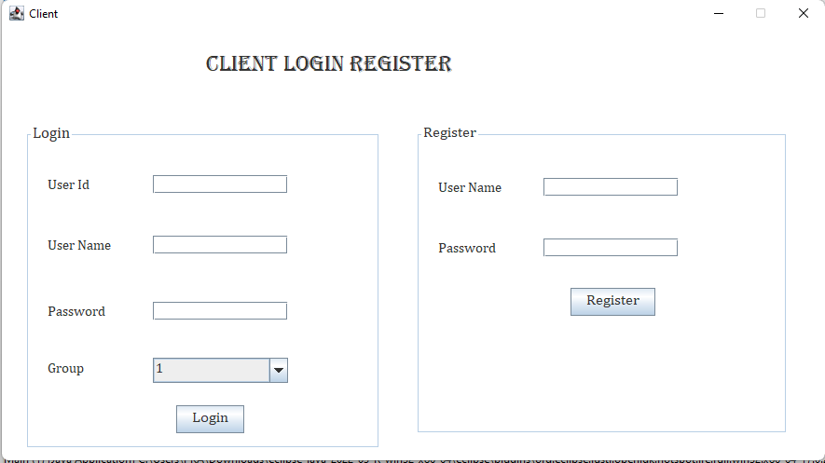
REGISTRATION UI :

Slide 21
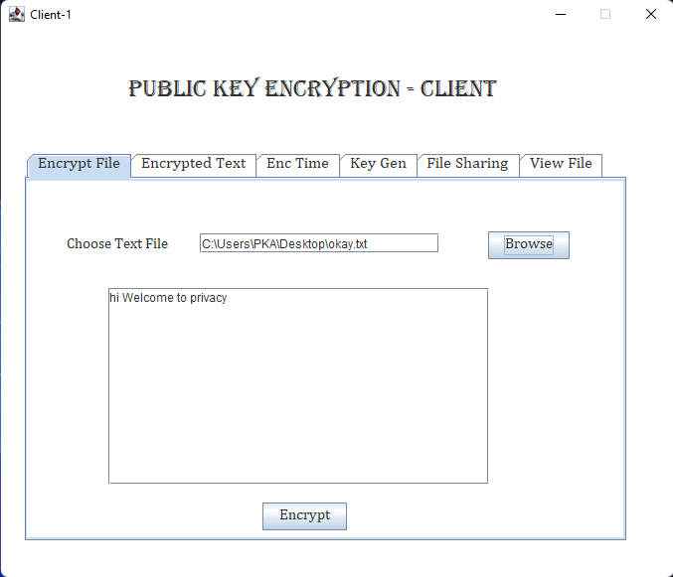
FILE UPLOAD :

Slide 22
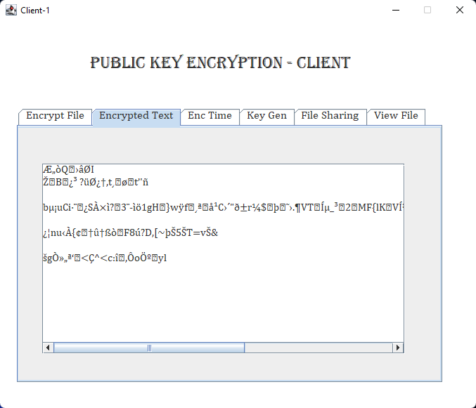
Encrypted Text :

Slide 23
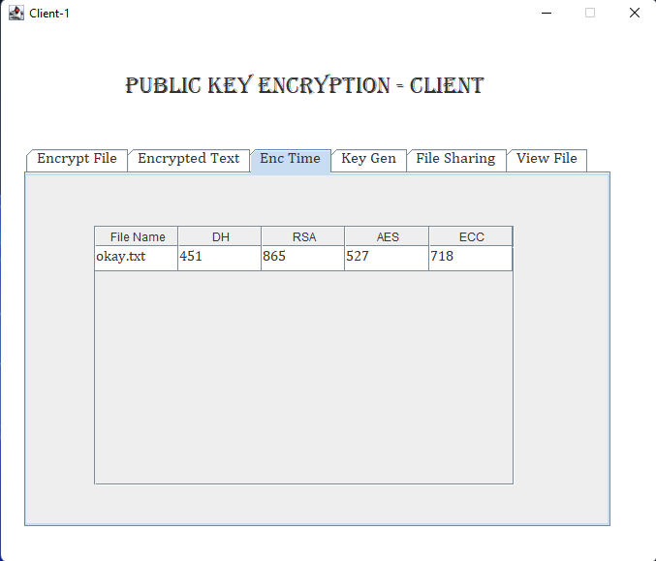
Encryption Time :

Slide 24
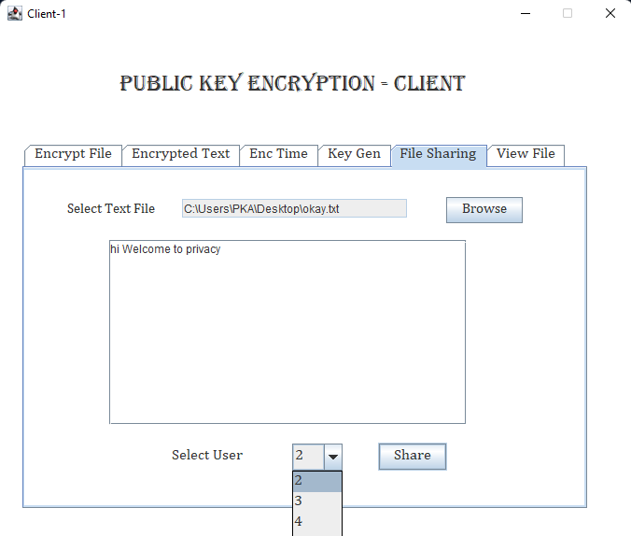
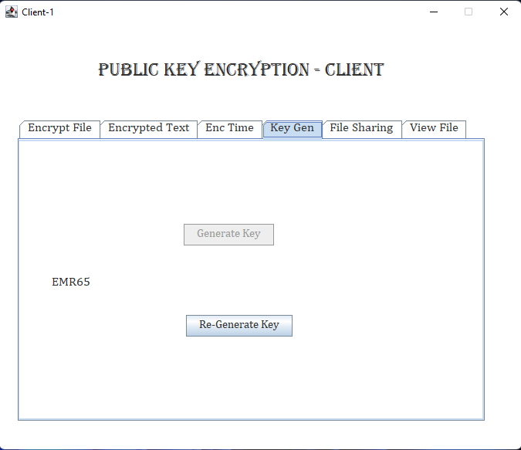
File sharing & Key Generation :

Slide 25
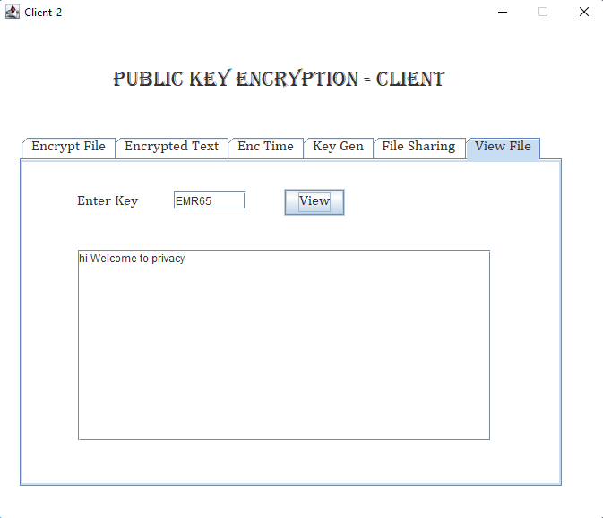
View File in Client 2 :

Slide 26
ADVANTAGES
Increased Data Security.
Computational and Communication cost is less.
Low Memory Usage.
High Throughput.
Faster Recovery.

Slide 27
CONCLUSION
The strength of cloud computing is the ability to manage risks in particular to security issues.
Security algorithms mentioned for encryption and decryption and ways proposed to access the multimedia content can be implemented in future to enhance security framework over the network.

Slide 28
REFERENCES
M. Aslam, C.Gehrmann, L.Rasmusson, and M.Bj¨orkman,(2012), “Securely launching virtual machines on trustworthy platforms in a public cloud - an enterprise’s perspective., ” in CLOSER, pp. 511– 521, SciTePress,.
B. Blanchet,(2001), “An efficient cryptographic protocol verifier based on prolog rules,” in Computer Security Foundations Workshop, IEEE, pp. 0082–0082, IEEE Computer Society.
D. Dolev and A. C. Yao,(1983), “On the security of public key protocols,” Information Theory, IEEE Transactions on, vol. 29, no. 2.
S. Graf, P. Lang, S. A. Hohenadel, and M. Waldvogel,(2012) “Versatile key management for secure cloud storage,” Reliable Distributed Systems, IEEE Computer Society, pp. 469– 474.
T. Garfinkel, B. Pfaff, J. Chow, M. Rosenblum, and D. Boneh, (2003),“Terra: A virtual machine-based platform for trusted computing,” in ACM SIGOPS Operating Systems Review, vol. 37, ACM.

